Slide 1

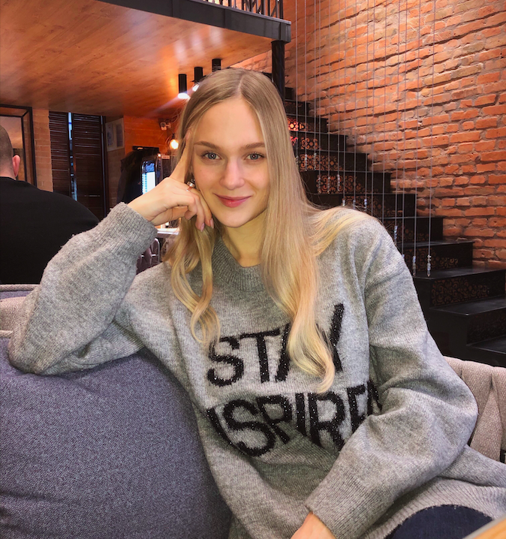
Daria Solodey
Methodist, course creator

Slide 3

Lesson Plan:
How to write a resume
Practice answering the question:
How are you improving your professional skills?
Notes:
Развернутый комментарий.

Slide 4

Look at the picture. What’s happening here?
What are we going to speak about today?

Slide 5




What ways of improving professional skills do you know?

Slide 6
Look through the list. Choose 1 or 2 points which are the most important to you for improving your professional skills? Explain your choice.
Overcome your fears
Learn something new
Ask for feedback
Observe others
Get a mentor
Work through challenging situations
Believe in yourself
Adapt to change

Slide 7
Have a look at the ways to improve your professional skills.
Do you do anything from this list?
1. Specialized course:
talk about a specialized course that you are taking to improve your skills.
2. After work-hours study:
talk about after work-hours study. You can mention names of online courses, magazines, books etc.
3. English learning:
talk about your English courses or that you are taking classes with a tutor. Speak about your achievements and how your English can help you at work.

Slide 8

How are you improving your professional skills?

Slide 9
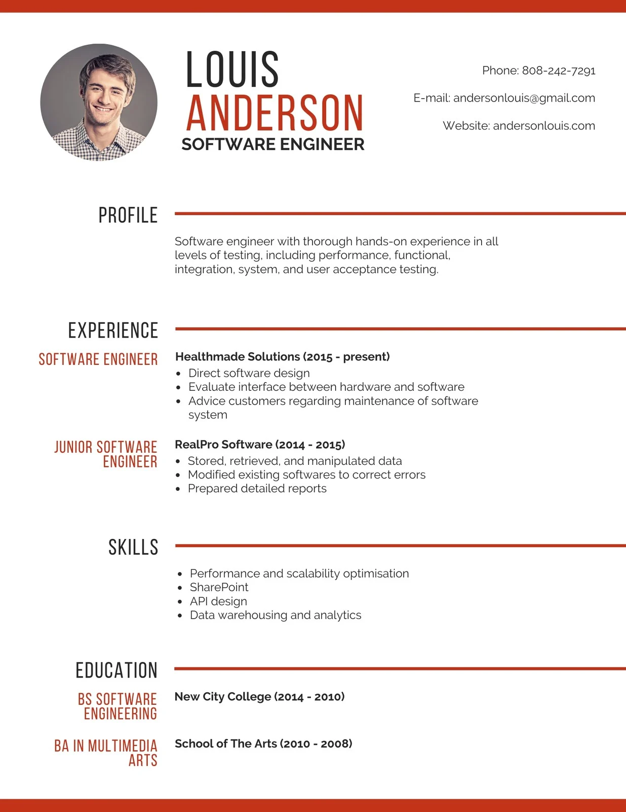
Have a look at the resume.
What does it consist of?

Slide 10
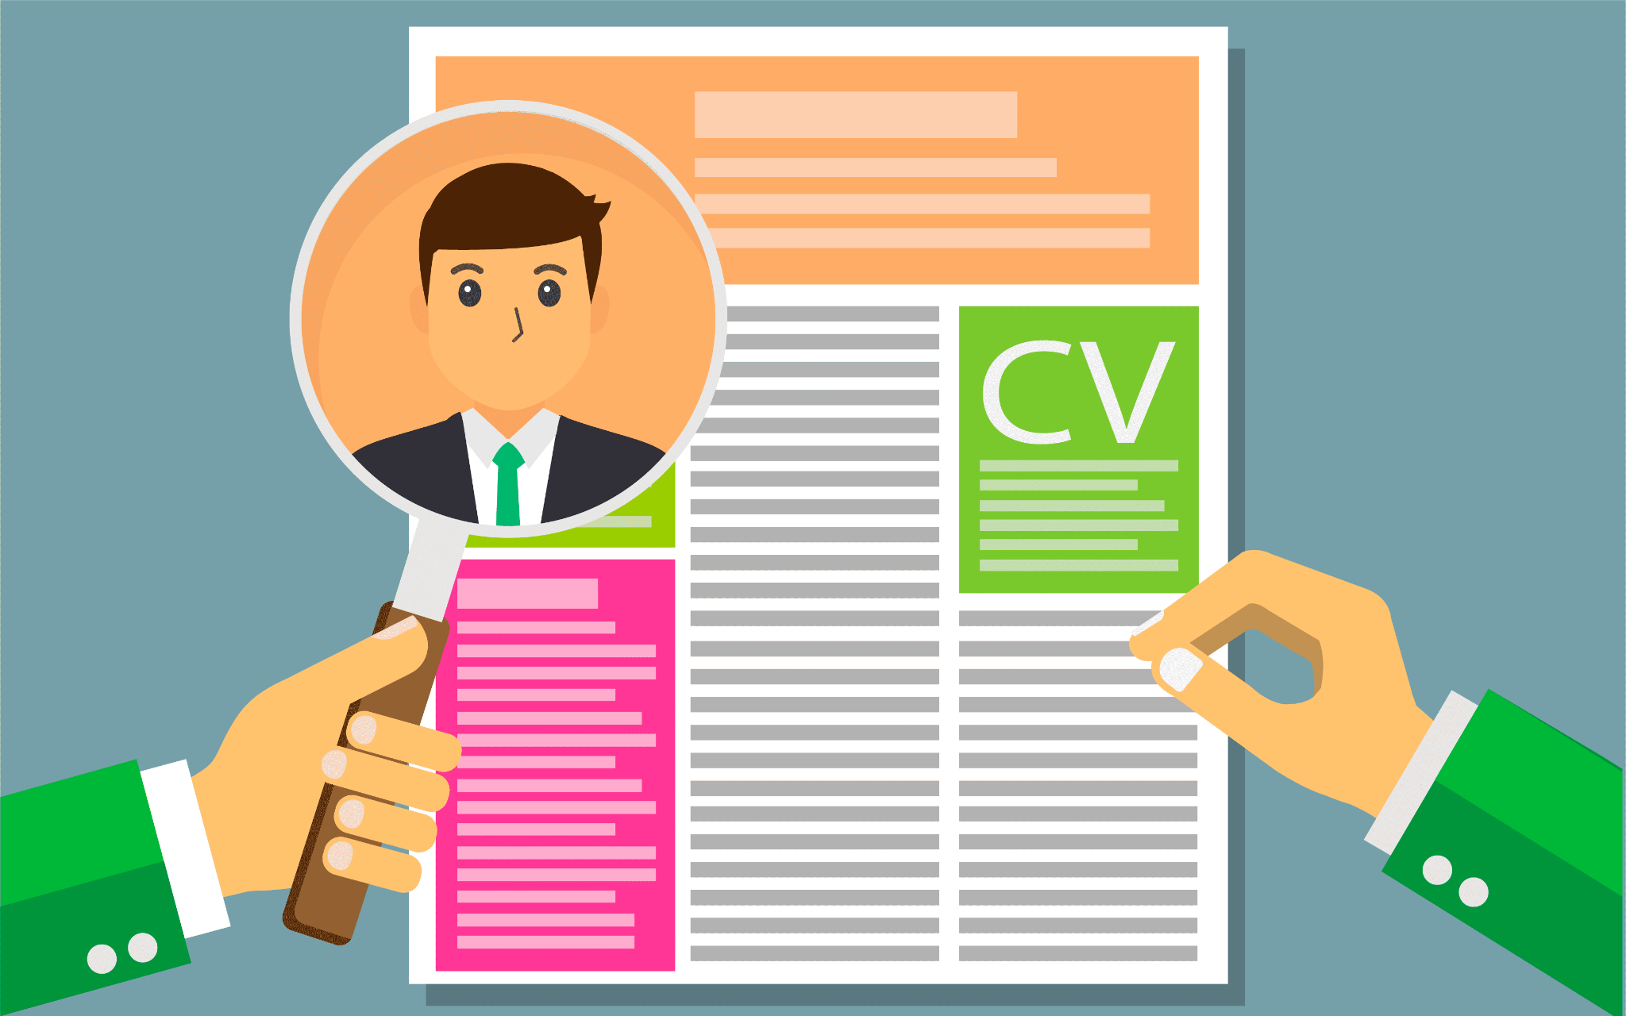
What mistakes do people usually make in their CVs (resumes)?
What is important to include in your CV (resume)?

Slide 11
Watch the video and answer the questions below
What is this video about?
What mistakes are fatal in your resume? Why are they fatal?
What should a resume tell recruiters?
What is T-style cover letter? Why is this format good?

Slide 12
How can you avoid these mistakes according to the video?
Why are they fatal?
Not proofreading your resume
TMI (too much information) - gender, date of birth, personal picture, nationality, marital status
Employment dates without months
Listing job duties
Making your resume too long
Failing to tailor your resume

Slide 13

You’re divided into 2 groups
Group A: list the mistakes in CV
Group B: list good tips you should follow to build a proper CV

Slide 14
HW:
write a CV

Slide 15

What can you do after this lesson?
I learned:
How to write a resume
How to answer the question:
How are you improving your professional skills?
Notes:
Развернутый комментарий

Slide 16
Useful links:
Video:
6 resume mistakes that can cost you the job
Words from this lesson:
Glossary 9

Slide 17
Thank you!

